Slide 1
Evaluation Proposal
Abteen and Peter
6/30/2023

Slide 2
Motivations
Models should be evaluated on their ability to handle new data
Tasks should:
Reflect real use cases
Consist of sufficient examples to draw confident conclusions
Not rely on highly-correlated or trivial features
Train-test leakage should be avoided
Forecasting ability must be evaluated

Slide 3
Proposal
Rather than creating a static dataset, develop an evaluation pipeline which can be re-generated in the future
Setup: Start with a snapshot of the Semantic Scholar citation graph G = (V, E) where nodes V contain features such as the title, author, abstract, full text, etc. and edges E may have features such as citing sentences or document location

Slide 4
Proposal
Assume that all nodes in the graph have a single associated publication date. Given G, select a date d which determines the cutoff between train and test
G_{d} = (V_{d} , E_{d} ) contains all nodes and citations before d, and is the only
object usable for training
To evaluate a system, we require as input a mapping from Semantic Scholar Corpus IDs to embeddings. These corpus IDs may correspond to papers published both before and after the split.

Slide 5
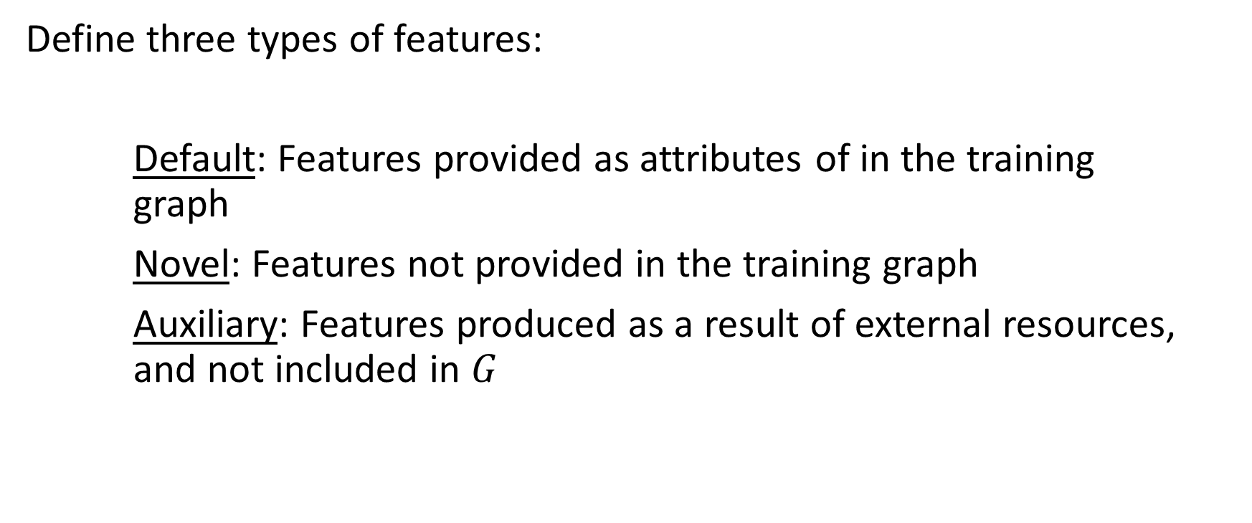
Proposal

Slide 6
Proposal
Define three types of tasks by the input nodes:
Known: A task if known if the set of input nodes are fully contained in the training graph. (Diagnostic task)
Known-Unknown: A task is known-unknown if the set of input nodes contains both nodes contained in the training graph and not.
Unknown: A task is unknown if none of the input nodes are contained in the training graph.
For tasks containing unseen nodes, we can further take into account the distance between publication date and split date.

Slide 7
Proposal
We can select multiple cut-off dates, to compare forecasting performance given longer histories.
Easy, known tasks, are diagnostic in that good performance doesn’t mean anything, but bad performance does. We can use this to evaluate forgetting

Slide 8
Tasks for next week
Create a framework for generating datasets from Semantic Scholar
Add support for Auxiliary data from S2ORC, OpenReview, etc
Add support for partitioning at a time-step and certain node data
Implement:
Publication Year
Venue Prediction

Slide 9
Proposal: Question 1
Whitelist or blacklist features?
Whitelist features: standardize input node features to: Title, abstract, author, full text
Blacklist features: e.g. not allowed to use field of study or subject/topic fields as inputs
Issue: avoid allowing highly correlated features to appear on either side of default/novel

